Slide 1
SHIFT CNN Implementation and Evaluation (Final Presentation)
ENGR-E 501 Final Project
Anthony Orlowski, Ryan Roy

Slide 2
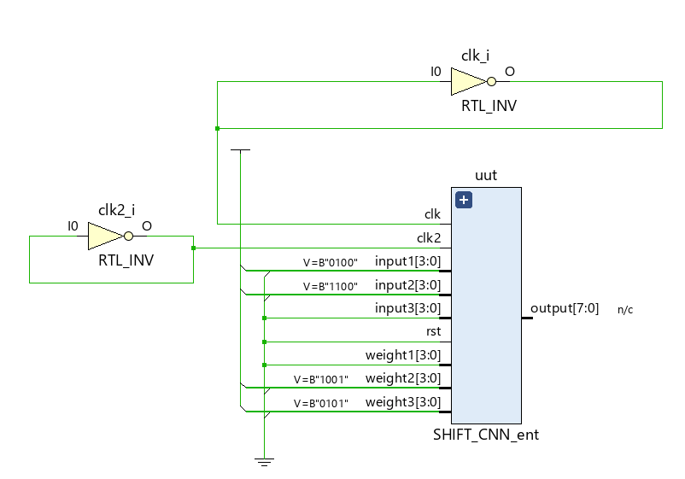
Agenda
Problem Description
Problem Importance
Quantization
Toy Example
Precomputed Tensor from Shift ALU
Array of Adders and Control Logic
Implementation Results
Limitations
Schedule

Slide 3
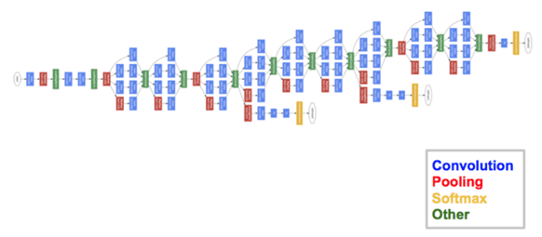
The problem description
One of the most computation intensive and power heavy operations in Convolutional neural net is the MAC operation.
Design and implementation of a customized FPGA/ASIC circuit to accelerate this operation could help us reduce computational-cost, latency, and power consumption at an acceptable trade-off of a minute reduction in accuracy. (4x reduction in power consumption, 2x reduction in no. of MAC operations, accuracy reduction of just 1%)
Convolutional neural network -
Notes:
As we saw in Prof Lei Jiang’s lecture, MAC in CNN convolution layers dominate the computation during inference. Inference computation allows for high parallelization, so we want to implement circuit on FPGA or ASIC that provides extremely efficient parallel computations when compared to CPU and GPU Shift CNN is “a generalized low-precision architecture for inference of multiplierless convolutional neural networks (CNNs).”
based on a power-of-two weight representation to performs only shift and addition operations which are cheaper than multiplication operations

Slide 4
Why the problem is important?
Recent developments in the field have made CNNs one of the most promising choices in research areas like computer vision with applications like image classification and semantic segmentation.
Since 2017 – a lot of research effort has been directed towards the implementation of this architecture for embedded systems and data centre deployments.
State-of-the-art CNNs can be converted without retraining into ShiftCNN with less than 1% drop in accuracy when the proposed quantization algorithm is employed
Architecture more suitable to be extended to support privacy sensitive applications that may replace the expensive (Levelled Fast Homomorphic Encryption over Torus) multiplications with cheap LTFHE shifts that makes use of encryption techniques like homomorphism while ensuring latency or error rate does not shoot up too much as compared to the conventional architecture.
Notes:
Current achievements of deep learning algorithms made them an attractive choice in many research areas including computer vision applications such as image classification (He et al., 2015), object detection (Redmon et al., 2016), semantic segmentation (Shelhamer et al., 2016) and many others.
Until recently real-time inference of deep neural networks (DNNs) and, more specifically, convolutional neural networks (CNNs) was only possible on power-hungry graphics processing units (GPUs).
research and implementation efforts (Sze et al., 2017) are conducted in the area of computationally inexpensive and power-efficient CNN architectures and their implementation forembedded systems as well as data center deployments.
Third, we present ShiftCNN design which achieves a factor of 4 reduction
in power consumption when implemented on a FPGA compared to conventional 8-bit fixed-point architectures
Add authors results here

Slide 5
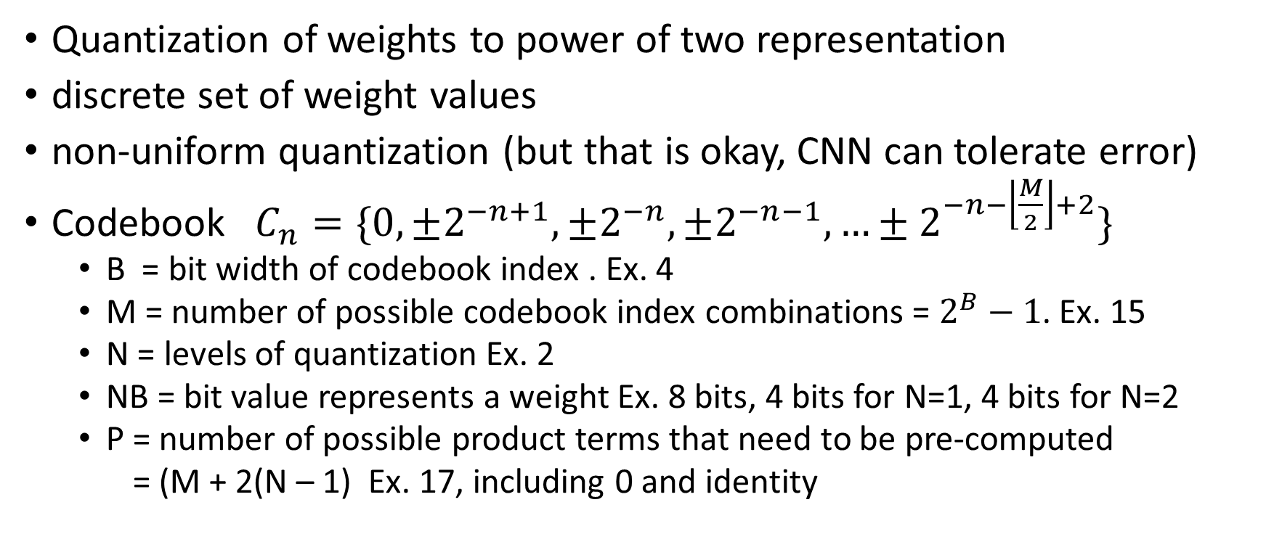
Solutions (Quantization of Weights)
Quantization of weights to power of two representation
discrete set of weight values
non-uniform quantization (but that is okay, CNN can tolerate error)
Codebook $C_{n}=\{0, ±2^{−n+1},±2^{−n},±2^{−n−1},…±2^{−n−\left\lfloor \frac{M}{2}\right\rfloor +2}\}$
B = bit width of codebook index . Ex. 4
M = number of possible codebook index combinations = $2^{B}−1$. Ex. 15
N = levels of quantization Ex. 2
NB = bit value represents a weight Ex. 8 bits, 4 bits for N=1, 4 bits for N=2
P = number of possible product terms that need to be pre-computed
= (M + 2(N – 1) Ex. 17, including 0 and identity
Notes:
Several approaches for a more computationally-efficient data representation
within CNNs have been proposed recently. One direction is to convert (quantize) a baseline
floating-point model into a low-precision representation using quantization algorithms. Such quantization algorithms can be classified into the following categories: fixed-point quantization (Courbariaux et al., 2015), binary quantization (Hubara et al., 2016; Rastegari et al., 2016), ternary quantization (Li and Liu, 2016) and power-of-two quantization (Miyashita et al., 2016; Zhou et al., 2017).
In this paper, we select power-of-two weight representation for building truly
multiplierless CNNs and, unlike (Miyashita et al., 2016; Zhou et al., 2017), employ a more general quantization algorithm which allows to achieve minimal accuracy drop without time-consuming retraining. In our architecture, inputs and feature maps are in the dynamic fixed-point format.

Slide 6
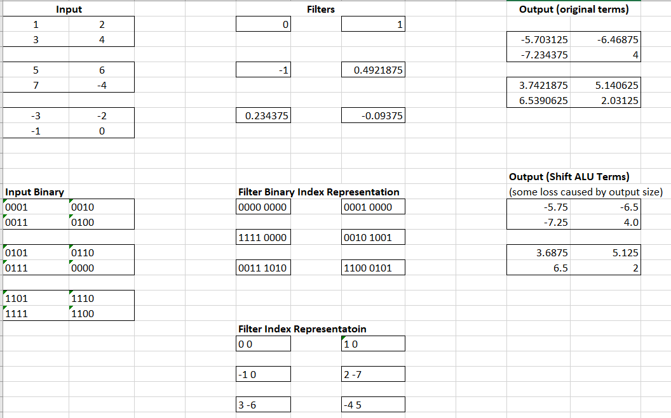
Toy Example

Slide 7
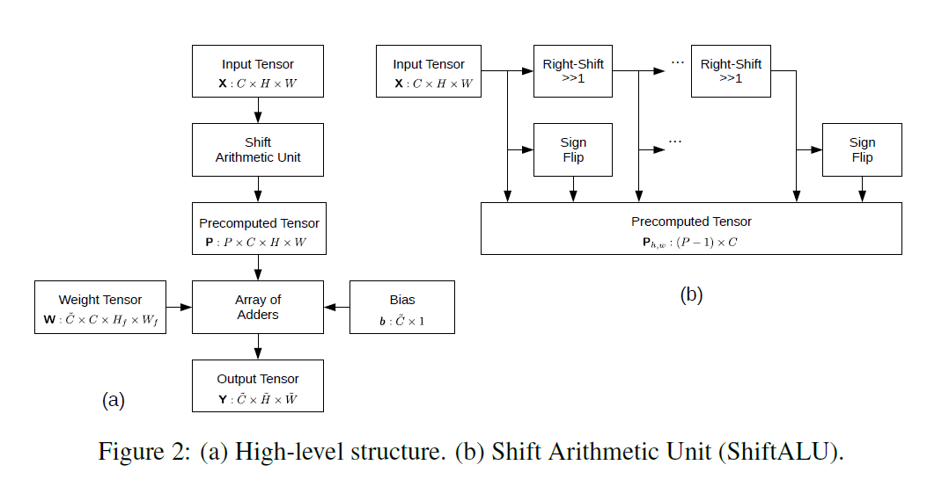
Solutions (Precompute Tensor with Shift ALU)
Multiplication is now a shift operation
Because P is so small, precompute all possible values of XW
Store precomputed tensor in array of shift registers
[1]

Slide 8
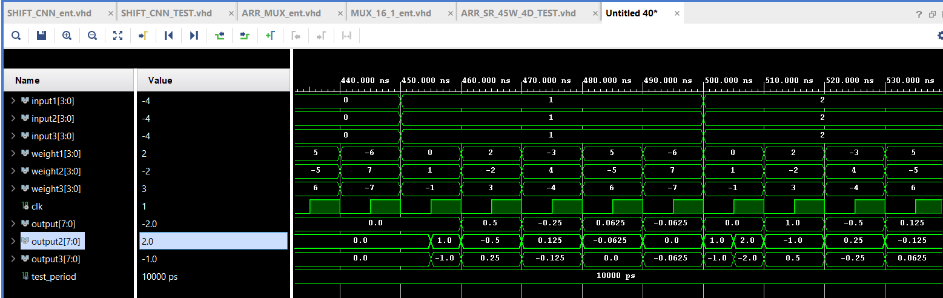
Solutions (Precompute Tensor with Shift ALU)
Interim test bench result demonstrating that our Shift ALU is sending the correct values to the array of mux

Slide 9
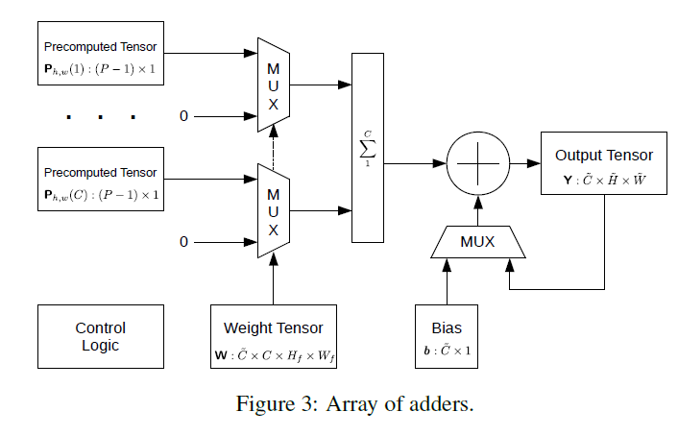
Solutions (array of adders and control logic)
C = 3
H = 2
W = 2
P = 15
B = 4
N = 2
[1]
[1]

Slide 10
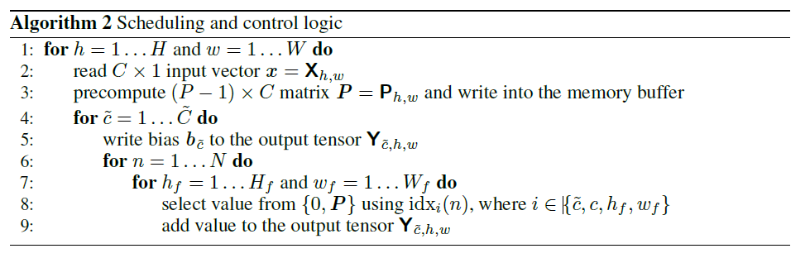
Solutions (array of adders and control logic)
[1]
[1]

Slide 11
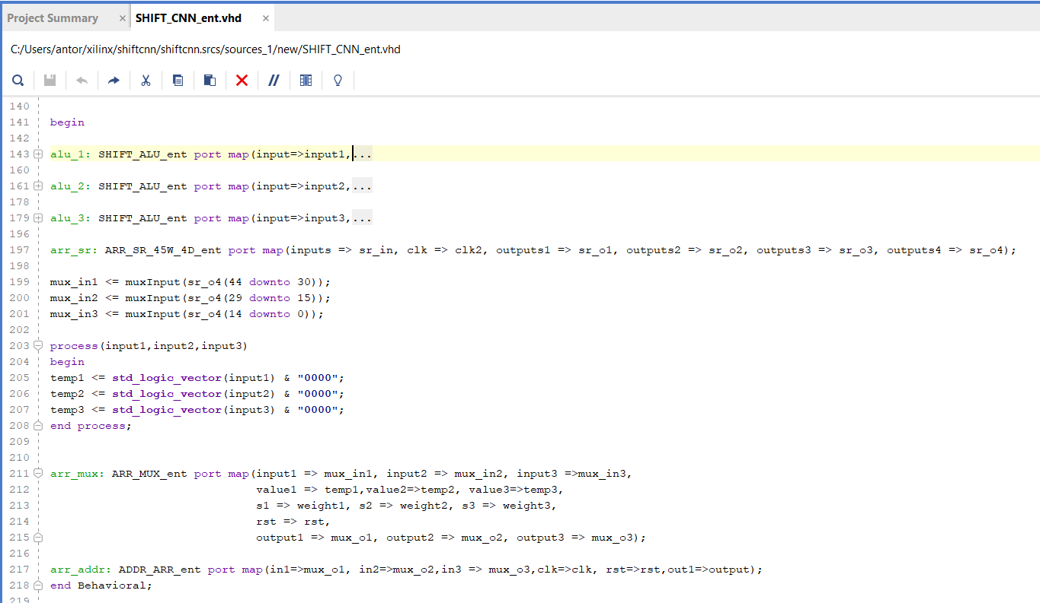
Implementation Results (SHIFT_CNN_ent)

Slide 12
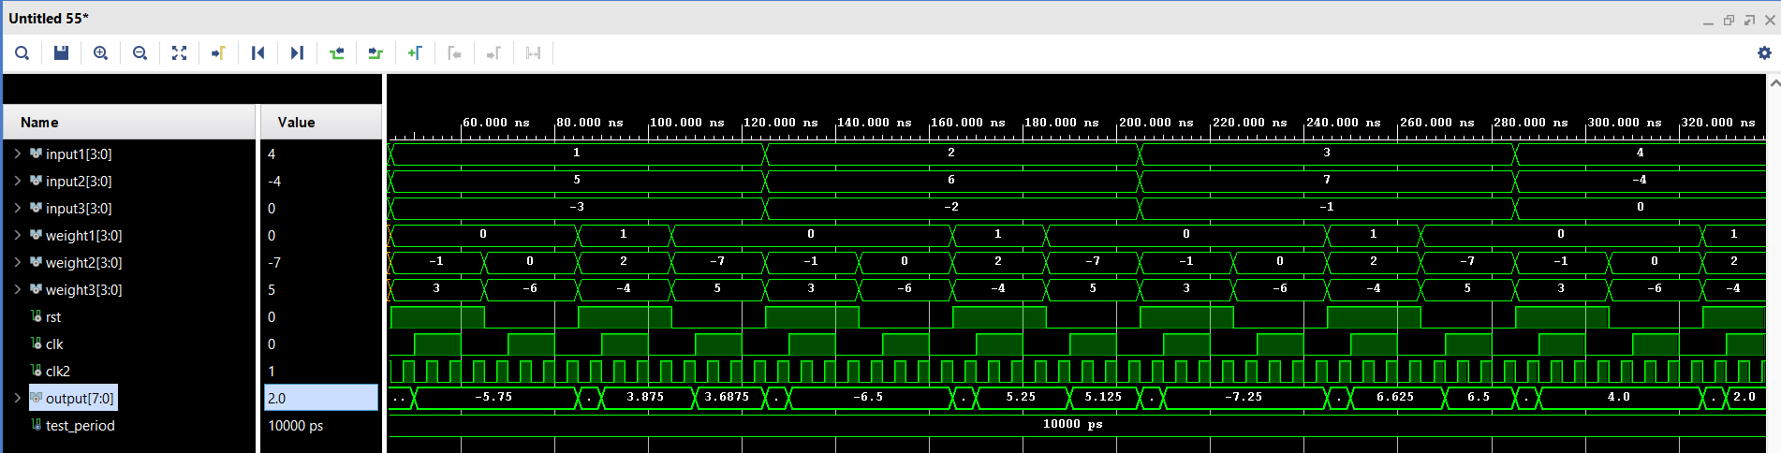
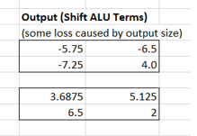
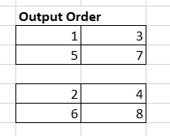
Implementation Results: Validation Test Bench

Slide 13
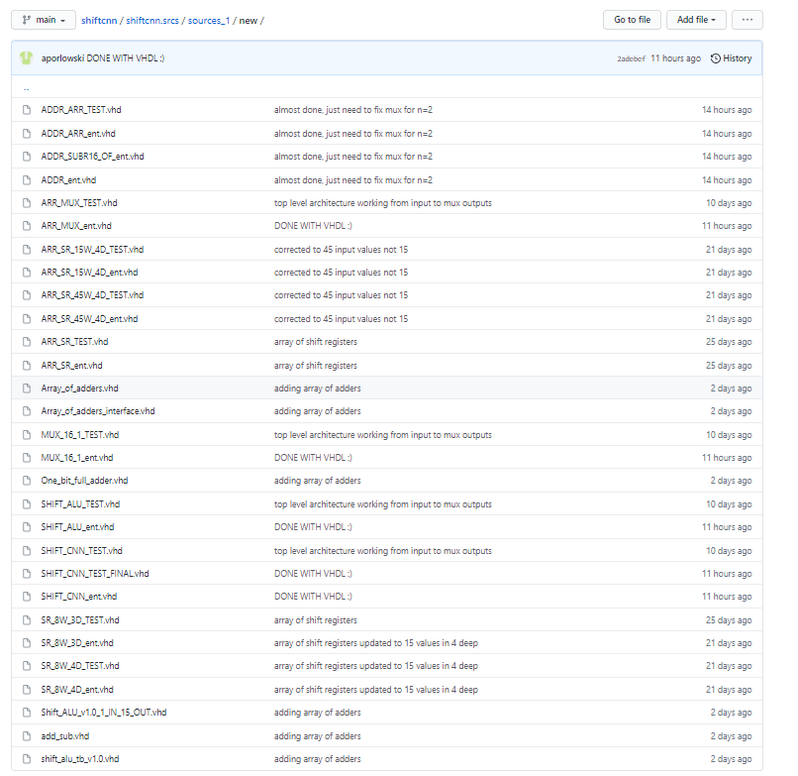
Implementation Results
Created at least 29 source file and test benches as we designed, iterated, and completed our implementation
Github at : https://github.com/aporlowski/shiftcnn/tree/main/shiftcnn.srcs/sources_1/new

Slide 14
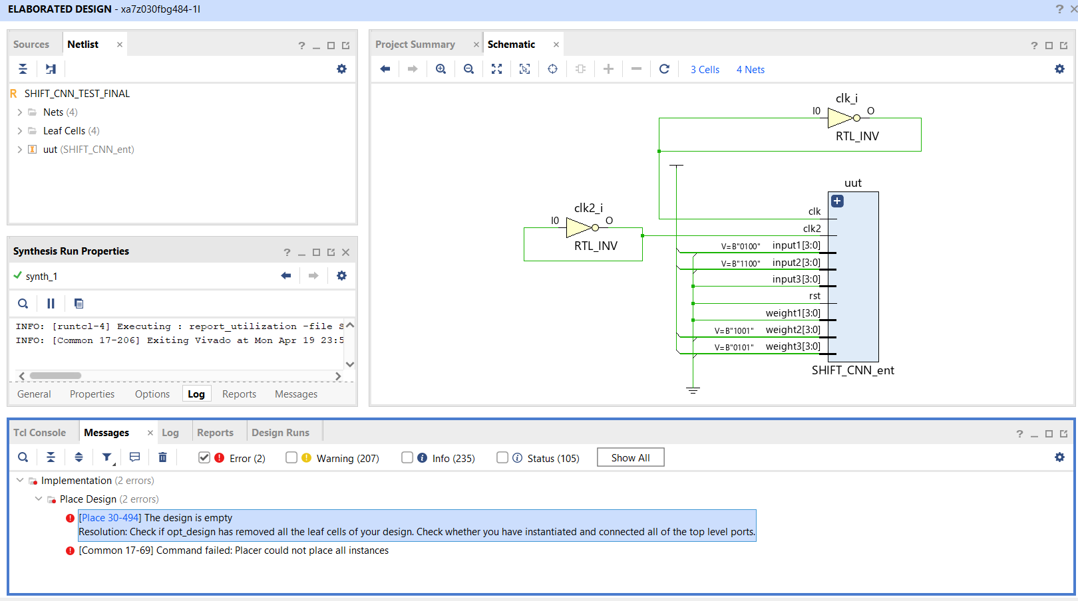
Limitations: Attempted to Synthesize

Slide 15
schedule (8 Week Plan)
19 MAR: Shift ALU and test bench (Ryan) (COMPLETE)
26 MAR: Array of Shift Registers and test bench (Anthony) (COMPLETE)
09 APR: Array of Mux and test bench (Anthony) (COMPLETE)
09 APR Array of Adders and test bench (Ryan, Anthony) (COMPLETE)
23 APR: Control Logic and test bench (Anthony) (COMPLETE)
30 APR: Synthesis of circuit and extrapolate to author results (LIMITED)
30 APR: Accuracy analysis of shift-cnn quantized SOA models on GPU (Ryan)
03 MAY: Final Report and Presentation (Both) (COMPLETE)

Slide 16
References
[1] Denis A. Gudovskiy, and Luca Rigazio, 2016, ShiftCNN: Generalized Low-Precision Architecture for Inference of Convolutional Neural Networks, https://arxiv.org/abs/1706.02393
[2] Philipp Gysel, Mohammad Motamedi & Soheil Ghias, 2016, HARDWARE-ORIENTED APPROXIMATION OF CONVOLUTIONAL NEURAL NETWORKS, https://arxiv.org/pdf/1604.03168.pdf
[3] RICARDO NÚÑEZ PRIETO, 2019, Implementation of an 8-bit Dynamic Fixed-Point Convolutional Neural Network for Human Sign Language Recognition on a Xilinx FPGA Board, https://www.eit.lth.se/sprapport.php?uid=1131
[4] Qian Lou, Lei Jiang, 2019, SHE: A Fast and Accurate Deep Neural Network for Encrypted Data.

Slide 17
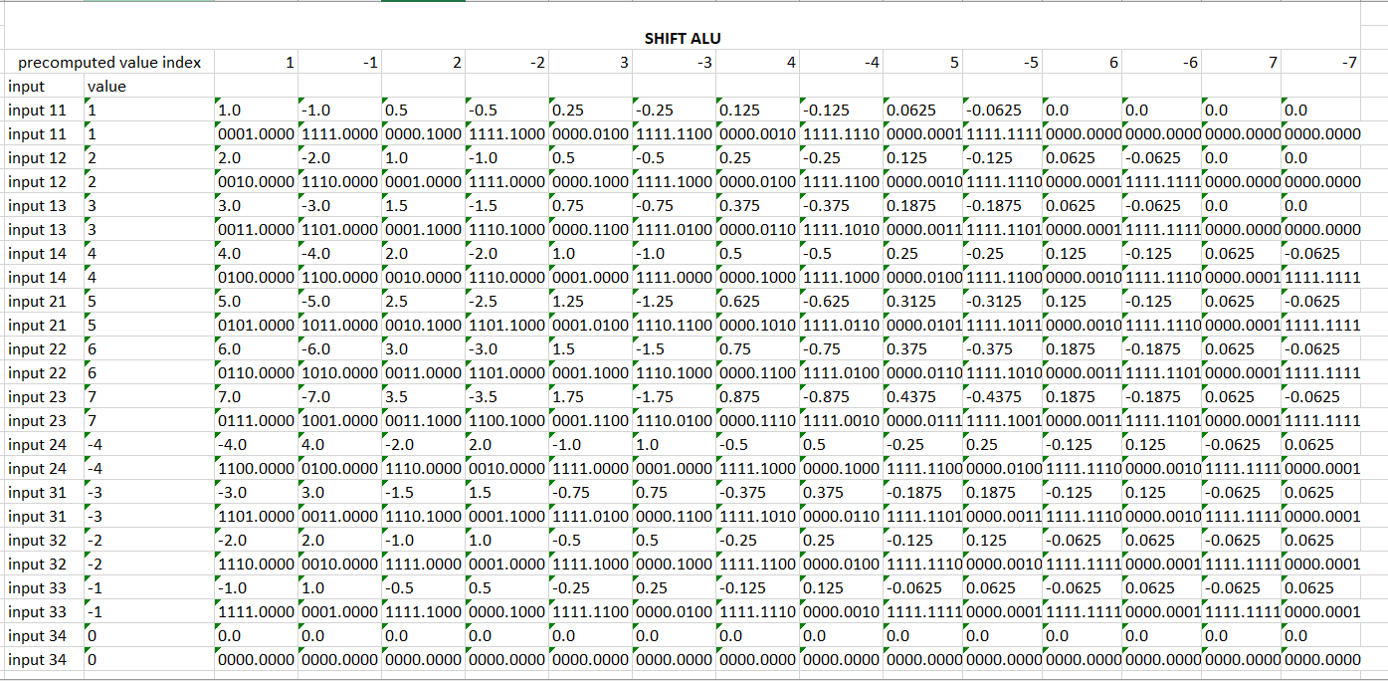
Toy Example

Slide 18
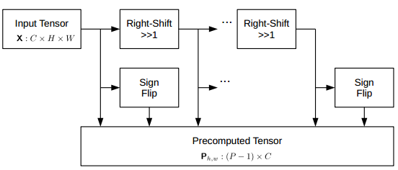
Shift ALU
Shift ALU performs two fundamental operations.

Slide 19
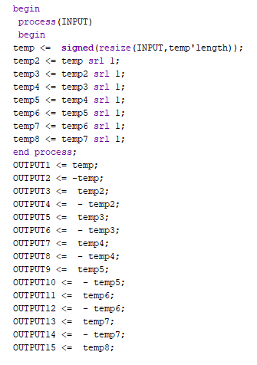
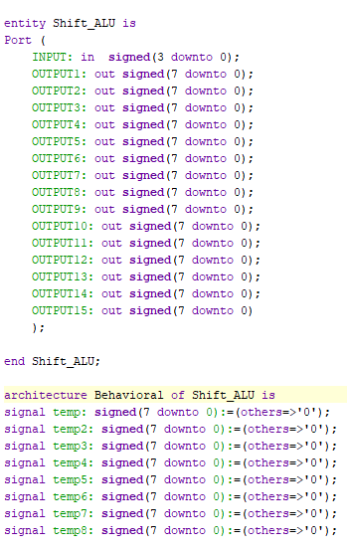
Shift ALU
It takes a single 4-bit signed value as integer and gives out 15 values (precomputed vector) that we would be using later on in the project

Slide 20
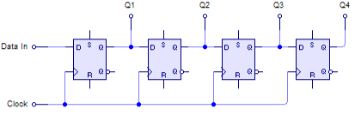
Array of Shift Registers
45 inputs (15 precomputed values x 3 input channels)
and store them 4 values deep (H * W = 4)
First made a SR to output 8 bit values stored 4 deep
Easy to implement with std_logic_vector (7 down to 0) ports
Learned about array types
https://vhdlwhiz.com/shift-register/

Slide 21
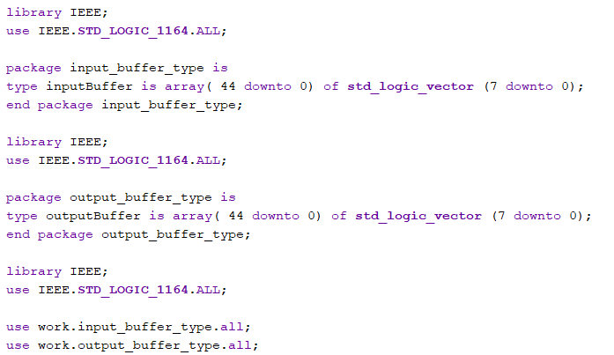
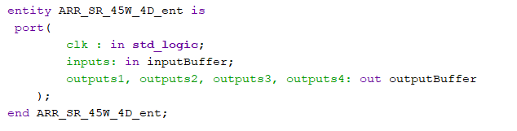
Array of Shift Registers
Next I connected 45 of these shift registers together
However, at first I did not use arrays which lead to very redundant and repetitive code
Likewise in my testbench I manually assigned all values instead of using a for loop

Slide 22
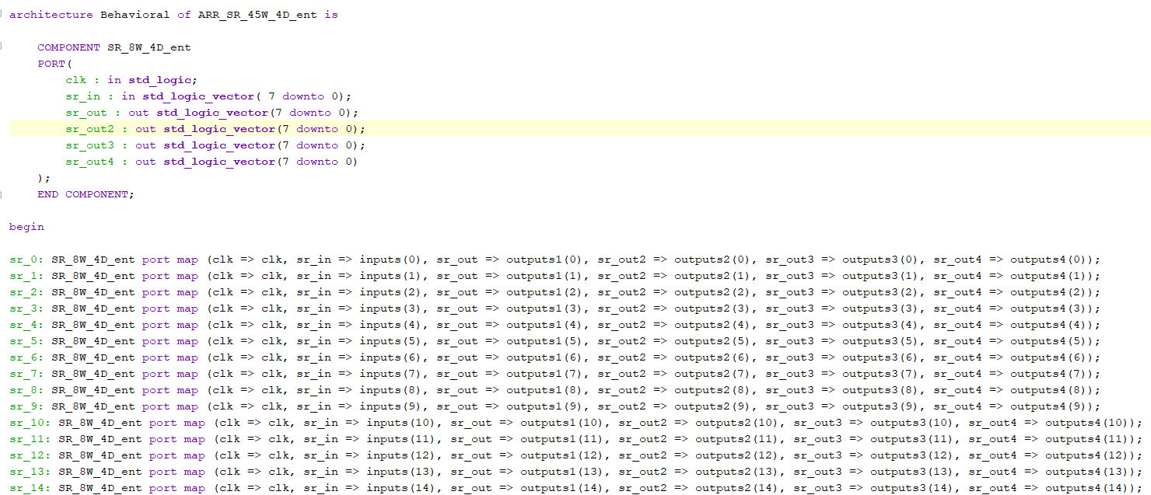
Array of Shift Registers
…
Still have some repetitive code
Need to figure out how I can simply this block of 45 entity copies

Slide 23
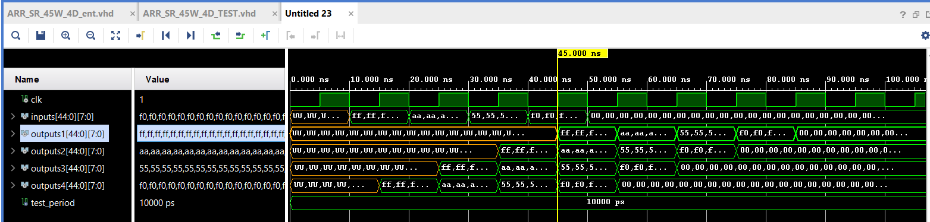
Array of Shift Registers

Slide 24
original schedule (8 Week Plan)
19 MAR: Shift ALU and test bench (Ryan) [Easy] (IN PROGRESS)
26 MAR: Array of Shift Registers and test bench (Anthony) [Easy] (COMPLETE)
09 APR: Array of Mux, Adders and test bench (Ryan) [Med]
23 APR: Control Logic and test bench (Anthony) [Hard]
30 APR: Synthesis of circuit and extrapolate to author results (Anthony) (Easy)
30 APR: Accuracy analysis of shift-cnn quantized SOA models on GPU (Ryan) [Med]
03 MAY: Final Report and Presentation (Both)

Slide 25
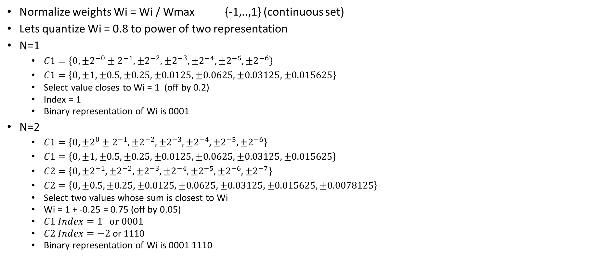
your solutions (Quantization of Weights)
Normalize weights Wi = Wi / Wmax {-1,..,1} (continuous set)
Lets quantize Wi = 0.8 to power of two representation
N=1
$C1=\left\{0,±2^{−0}±2^{−1},±2^{−2},±2^{−3},±2^{−4},±2^{−5},±2^{−6}\right\}$
$C1=\left\{0, ±1,±0.5, ±0.25, ±0.0125, ±0.0625, ±0.03125,±0.015625\right\}$
Select value closes to Wi = 1 (off by 0.2)
Index = 1
Binary representation of Wi is 0001
N=2
$C1=\left\{0,±2^{0}±2^{−1},±2^{−2},±2^{−3},±2^{−4},±2^{−5},±2^{−6}\right\}$
$C1=\left\{0, ±1,±0.5, ±0.25, ±0.0125, ±0.0625, ±0.03125,±0.015625\right\}$
$C2=\left\{0,±2^{−1},±2^{−2},±2^{−3},±2^{−4},±2^{−5},±2^{−6},±2^{−7}\right\}$
$C2=\left\{0, ±0.5, ±0.25, ±0.0125, ±0.0625, ±0.03125,±0.015625, ±0.0078125\right\}$
Select two values whose sum is closest to Wi
Wi = 1 + -0.25 = 0.75 (off by 0.05)
$C1 Index=1 o$r 0001
$C2 Index=−2$or 1110
Binary representation of Wi is 0001 1110

Slide 26
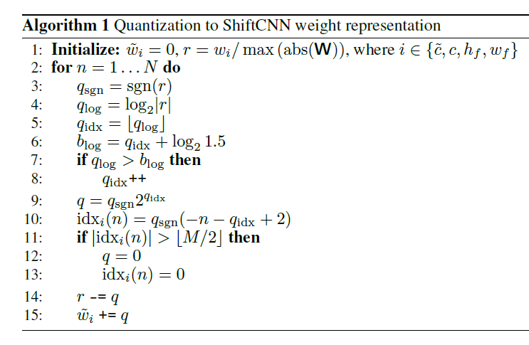
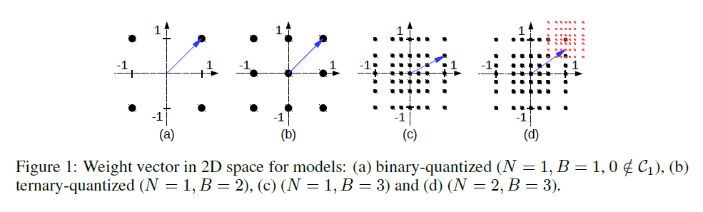
your solutions (Quantization of Weights)
[1]
[1]

Slide 27

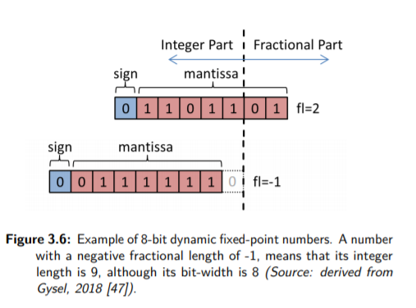
your solutions (Dynamic Fixed Point Format)
Inputs for shift cnn are in dynamic fixed point format
This allows a dynamic range of layer outputs (typically larger) and layer weights (typically smaller)
Can conduct multiplication / division with a simple bit shift operation
Let us represent 8.5
fl = 2
001000.10
Let us represent 8
fl = -2
00000010 [00]
[2]
[3]
Notes:
In our architecture, inputs and feature maps are in the dynamic fixed-point format. Here B denotes the bit-width, s the sign bit, fl is the fractional length, and x the mantissa bits. The intermediate values in a network have different ranges. Therefor it is desirable to assign fixed point numbers into groups with constant fl, such that the number of bits allocated to the fractional part is constant within that group. Each network layer is split into two groups: one for the layer outputs, one for the layer weights. This allows to better cover the dynamic range of both layer outputs and weights, as weights are normally significantly smaller. On the hardware side, it is possible to realize dynamic fixed point arithmetic using bit shifters.

Slide 28
your solutions (Array of Adders)
[1]
[1]

Slide 29
your schedule (8 Week Plan)
19 MAR: Shift ALU and test bench (Ryan) [Easy]
26 MAR: Array of Shift Registers and test bench (Anthony) [Easy]
09 APR: Array of Mux, Adders and test bench (Ryan) [Med]
23 APR: Control Logic and test bench (Anthony) [Hard]
30 APR: Synthesis of circuit and extrapolate to author results (Anthony) (Easy)
30 APR: Accuracy analysis of shift-cnn quantized SOA models on GPU (Ryan) [Med]
03 MAY: Final Report and Presentation (Both)

Slide 30
and evaluation plan.
Test benches for individual components
Test bench to compute toy convolution 2x2x3 input. 1x1x3 filter, stride=1, 2x2x3 output. B=4, N=2
Synthesize our circuit and identify # LUT, # FF, Power, Relative Power. Extrapolate our numbers compared to authors. It is unclear how large of an example they made, so we at least hope to see similar ratios.
Confirm authors accuracy by quantizing SOA models and measuring accuracy on GPU

